Slide 1
Sentiment Analysis of Yelp Reviews by Machine Learning
[GROUP -11] Jayanth Reddy Karra (11600307) Shaik Abjal Hussain (11643584) Sai Venkata Manish Lingamallu (11656571) Bhanavi Nimmagadda (11557848) Sai Jaswanth Raja (11656571)

Slide 2
Abstract
Create and deploy a sentiment analysis system for Yelp reviews using machine learning and construct a robust model to classify user-generated evaluations as positive, negative, or neutral.
Provide valuable insights into customer sentiments.
Employ methodologies like text preprocessing, feature engineering, and supervised learning.
Aim for high accuracy in classifying reviews. Explore enhancements, including deep learning and ensemble techniques, to improve model efficacy.

Slide 3
Introduction
Sentiment analysis plays a crucial role in understanding user opinions and feedback.
This project aims to predict star ratings of Yelp reviews using a multilayer perceptron classifier.
The chosen methodology involves preprocessing the text data, transforming it into a suitable format, and training a classifier for prediction.

Slide 4
Methodology: Coding Phase
Data Loading and Exploration:
Yelp dataset was loaded and summarized.
Data Preprocessing:
A new column 'length' was created to hold the length of each review.
The relationship between star ratings and review length was visualized.
Text data was preprocessed using NLTK.
The text was converted to vectors using the CountVectorizer.
Dataset Splitting:
The dataset was split into training and testing sets.
Multilayer Perceptron Classifier:
A multilayer perceptron classifier (MLP) was implemented using scikit-learn.
The classifier was trained on the training set and evaluated on the testing set.

Slide 5
Methodology: Simulation Phase
Confusion Matrix Visualization:
Confusion matrix was visualized as a heatmap using Seaborn.
Random Rating Predictions:
Random reviews from the dataset were selected, and their actual and predicted ratings were printed.
Custom Review Predictions:
Sample negative, positive, and neutral reviews were provided to the trained model for rating prediction.
Predicted ratings were printed for each custom review.
Star Rating Distribution:
The distribution of star ratings in the dataset was visualized using a bar chart.

Slide 6
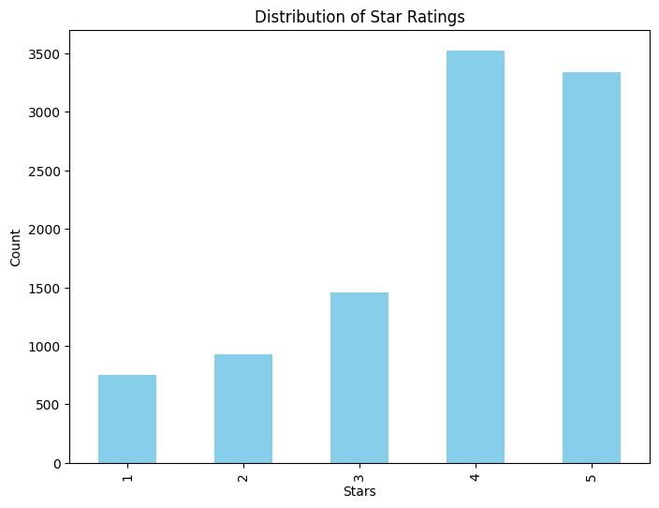
Star Rating Distribution
It can be observed that most of the reviews were biased towards the positive side as most of them had a rating of 4 and 5 unlike those that had 1, 2 and 3.

Slide 7
Results
The MLP classifier achieved a certain level of accuracy on the testing set, reaching approximately 78%.
The confusion matrix heatmap provided insights into the classifier's performance, indicating areas of correct and incorrect predictions.

Slide 8
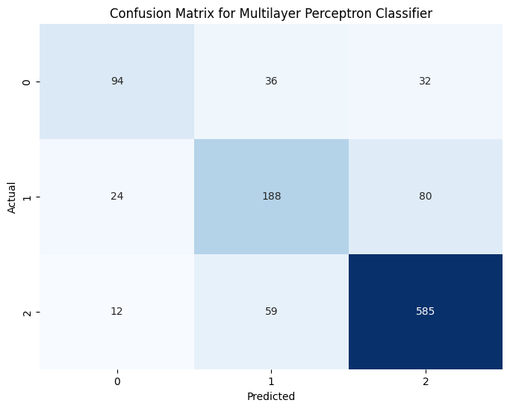
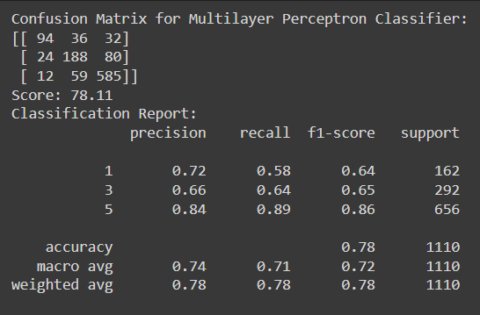
Results: Confusion Matrix & Report

Slide 9
Conclusion
Sentiment analysis of Yelp reviews using a multilayer perceptron classifier shows promise in predicting user ratings based on textual content.
The project successfully applies natural language processing and machine learning techniques to analyze and classify sentiment in reviews.

Slide 10
References
Reference Paper:
https://ieeexplore.ieee.org/document/9065812
Scikit-learn documentation:
https://scikit-learn.org/stable/documentation.html
NLTK documentation:
https://www.nltk.org/documentation.html
Yelp dataset:
https://www.yelp.com/dataset/documentation/sql

